Slide 1
Training Lecture #1
Brian Ta
brianta46@gmail.com

Slide 2

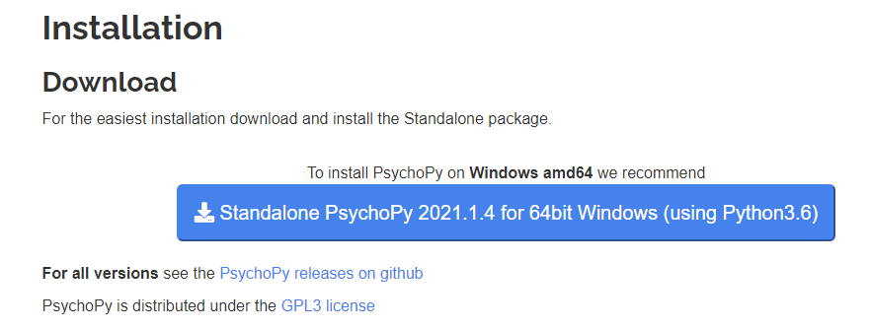
Download & Install PsychoPy
Free to use
Commonly used for behavioral experiments (neuroscience, psychology, etc.)
Reaction Time Experiments Responding to Different Visual Stimuli
Written in Python
Download here
Note that the 2021 version of PsychoPy has a different visual layout than the 2020 version that is used here

Slide 3
Computer Setup
Once ready to begin,
Hook up computer to large TV (55 in. or larger) via HDMI
Alternatively, a laptop or monitor will work, however a large TV is preferable
Download monitor_calibration.py
Download “Faces” folder and unzip
Open through PsychoPy
When completed, an eccentricity_monitor_calibration.csv will be created in the folder containing the original script
Refer to next few slides for details and troubleshooting

Slide 4
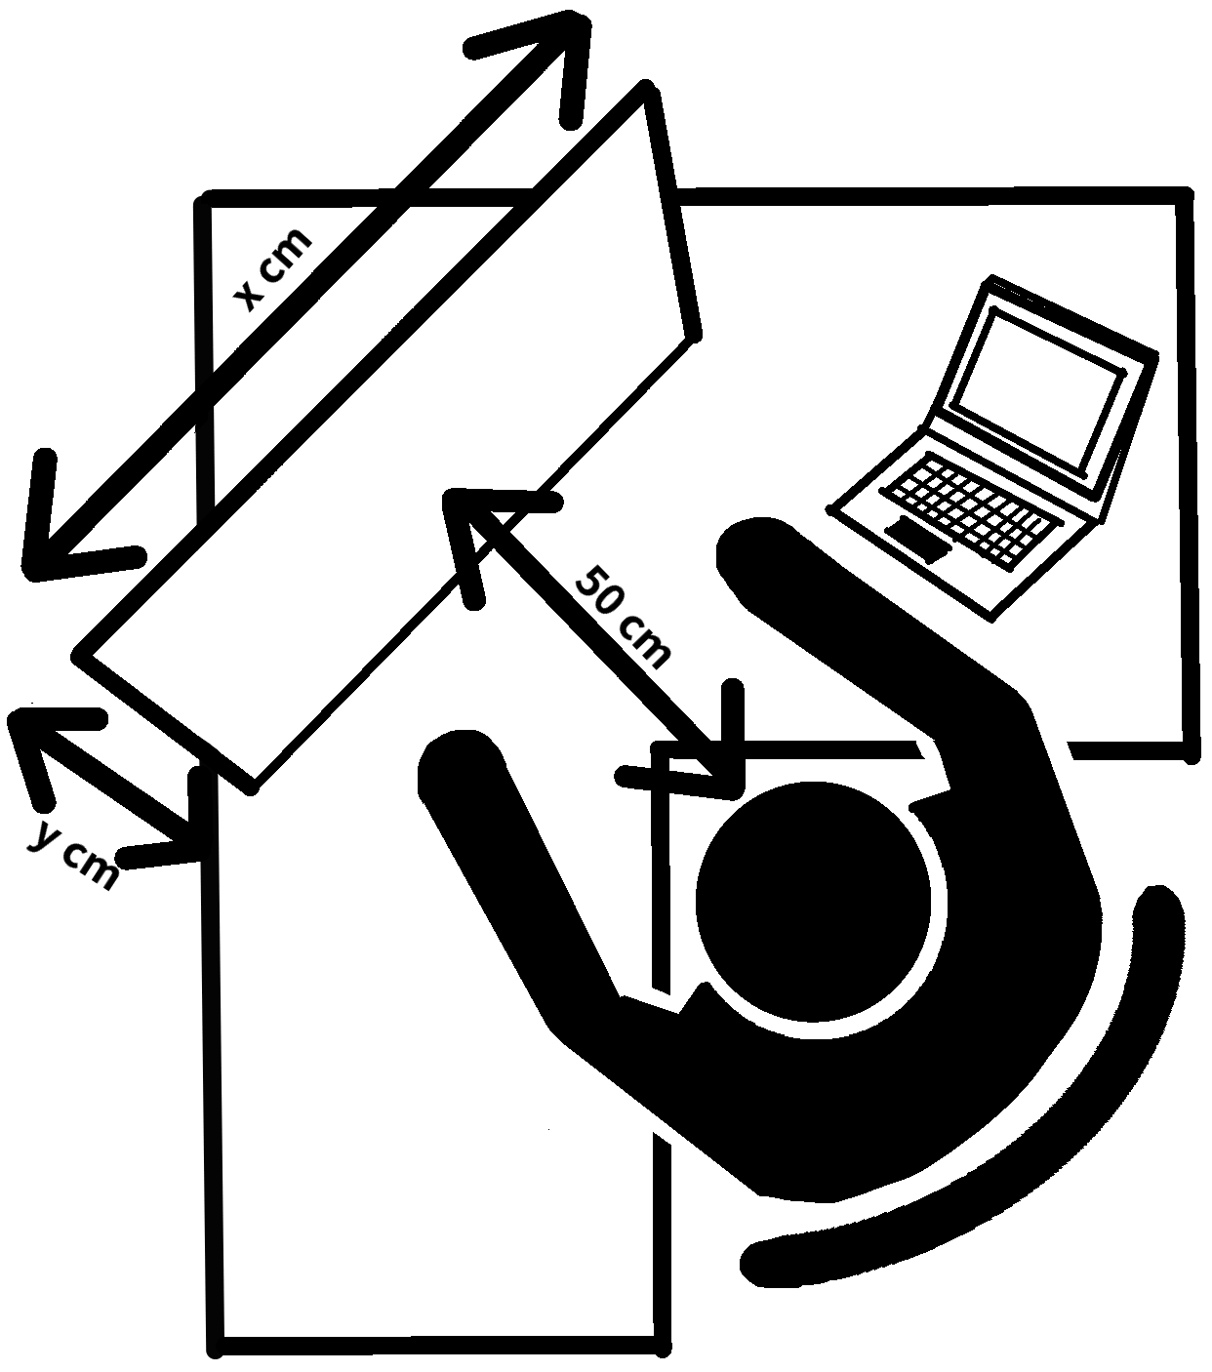
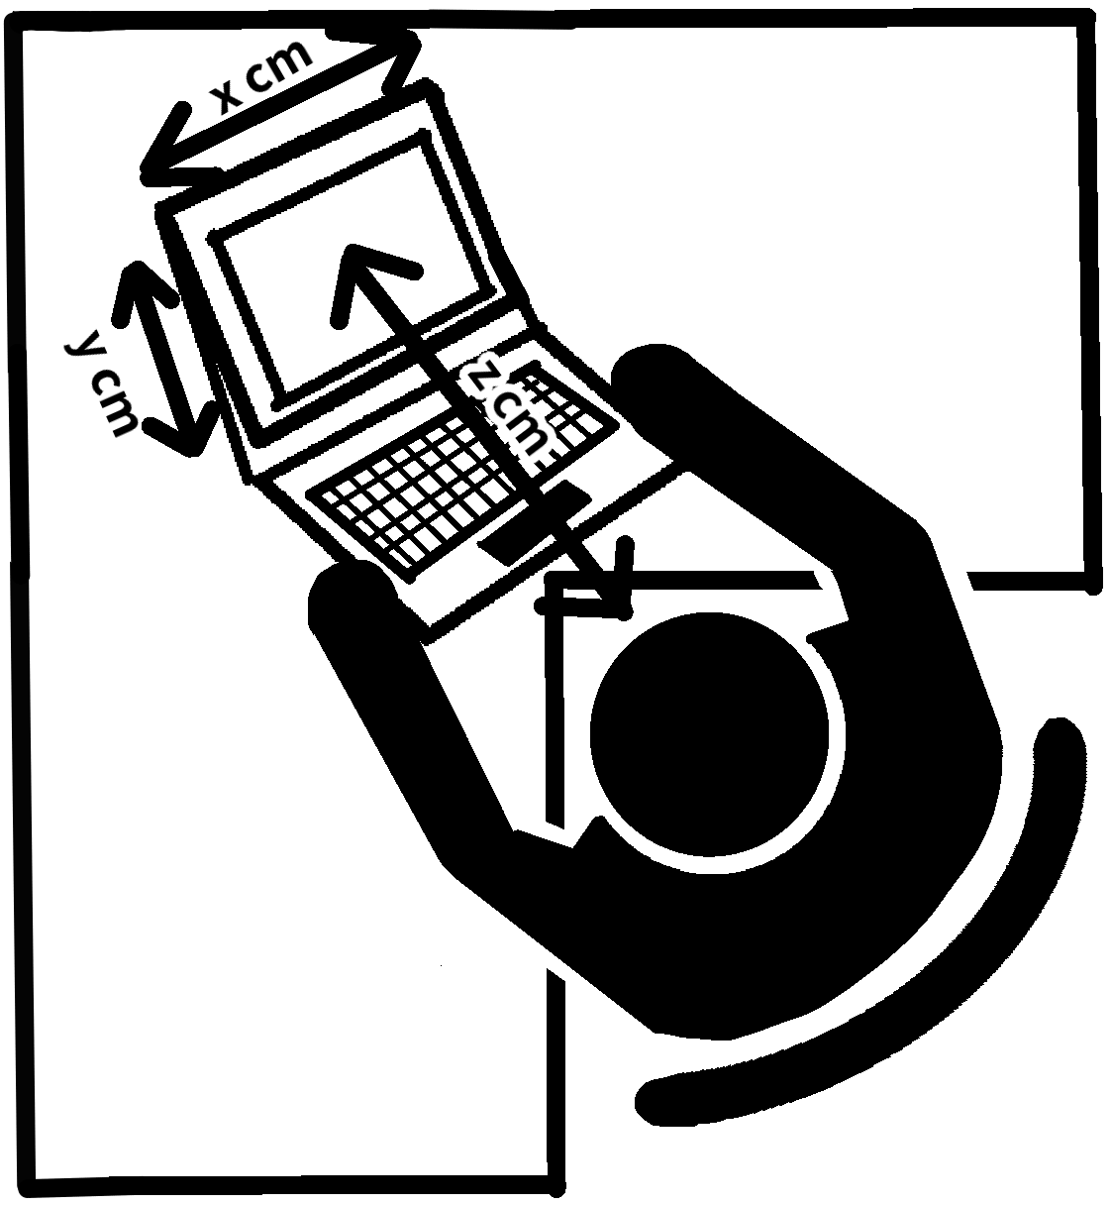

Slide 5
Download “Faces” Folder for Calibration
Download folder and unzip
Make sure “Faces” is in the same folder as the calibration.py script
Do not put the calibration.py into the “Faces” folder

Slide 6
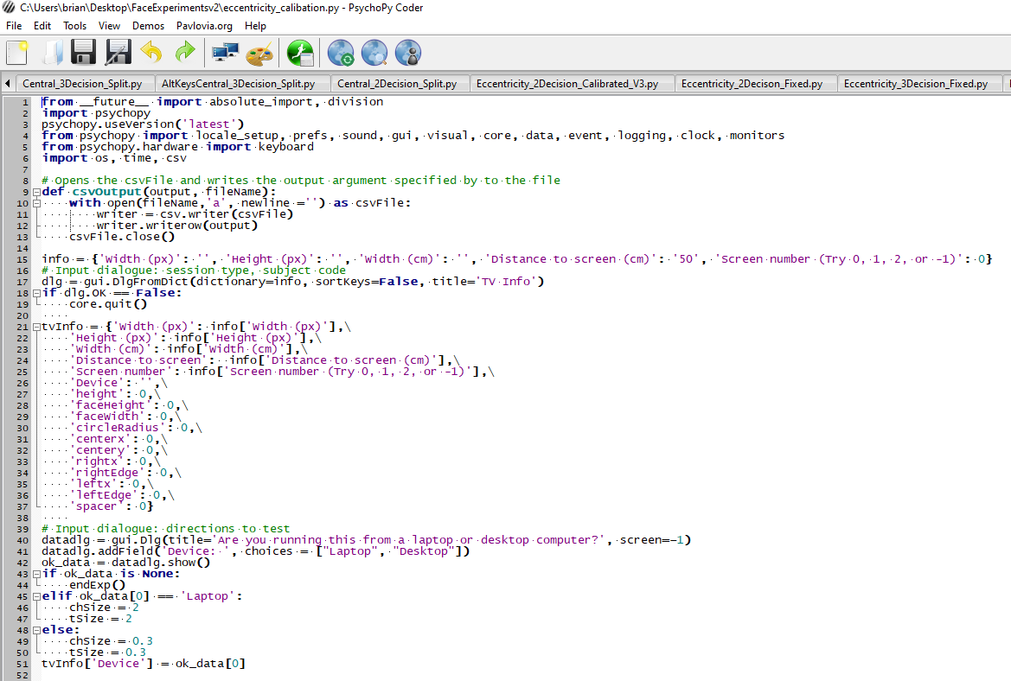
1. Click “Monitor,” see next slide

Slide 7
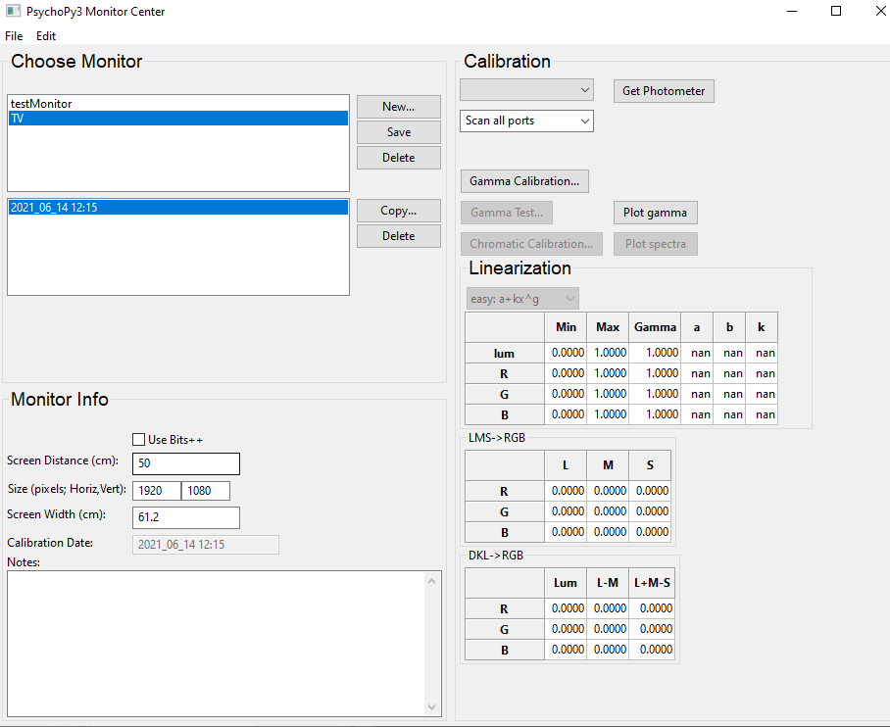
1. Click “New” and add a new monitor called “TV”
3. Click Save
2. Fill in your display specs.
Keep “Screen Distance” as 50 cm

Slide 8
2. Click to run
1. Find and open the calibration script

Slide 9
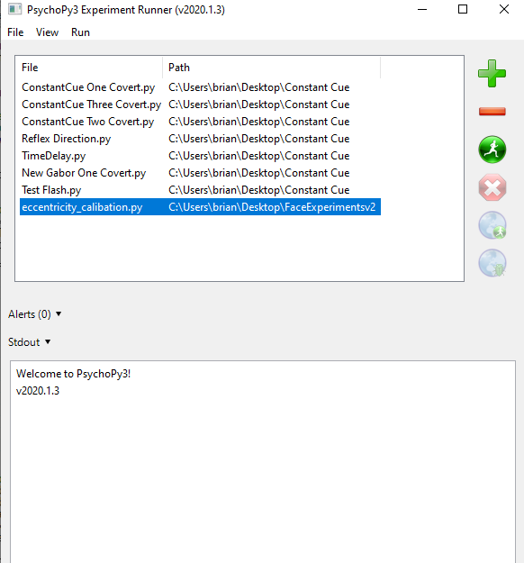
3. Click to run

Slide 10
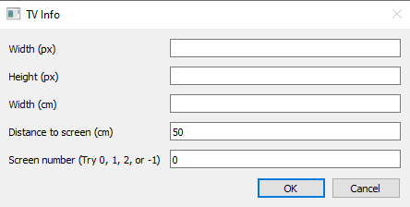
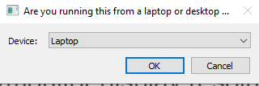
Details
Fill in Width and Height (in pixels) and measure Width of monitor using a ruler
Find your TV/monitor display resolution
Look under your laptop Display settings
Common resolutions:
Width x Height
1920 x 1080 (1080p, FHD)
3840 x 2160 (4k, UHD)
Change to Desktop if font too large

Slide 11
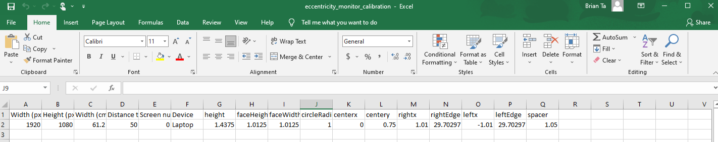
At the end of the calibration, the gray experiment window will automatically close. Look through the folder containing the calibration.py script to find the file below (eccentricity_monitor_calibration.csv)
If your file has this information, you have completed the calibration!

